Slide 1
Class Diagrams
Week 5

Slide 2
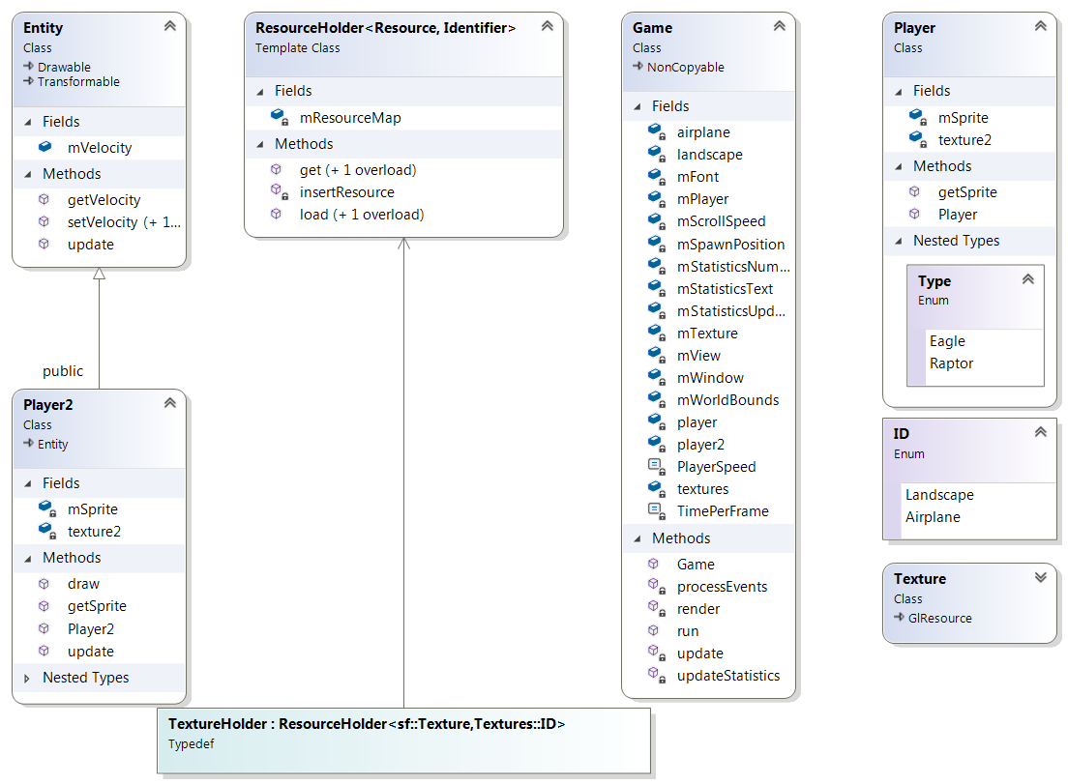
Entity

Slide 3
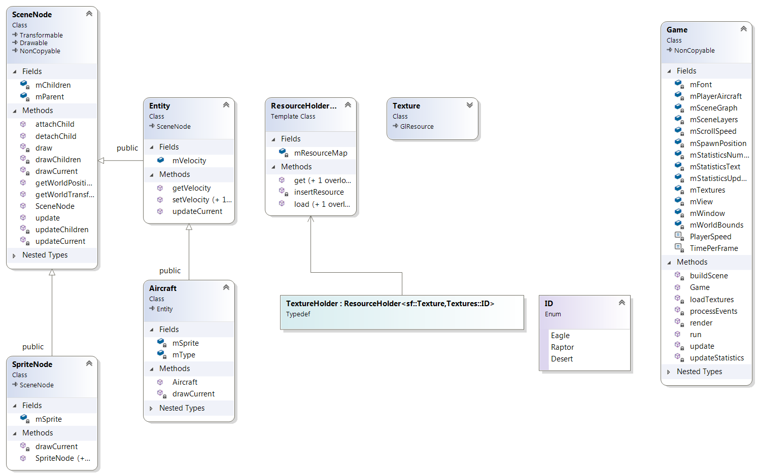
Scene Node

Slide 4
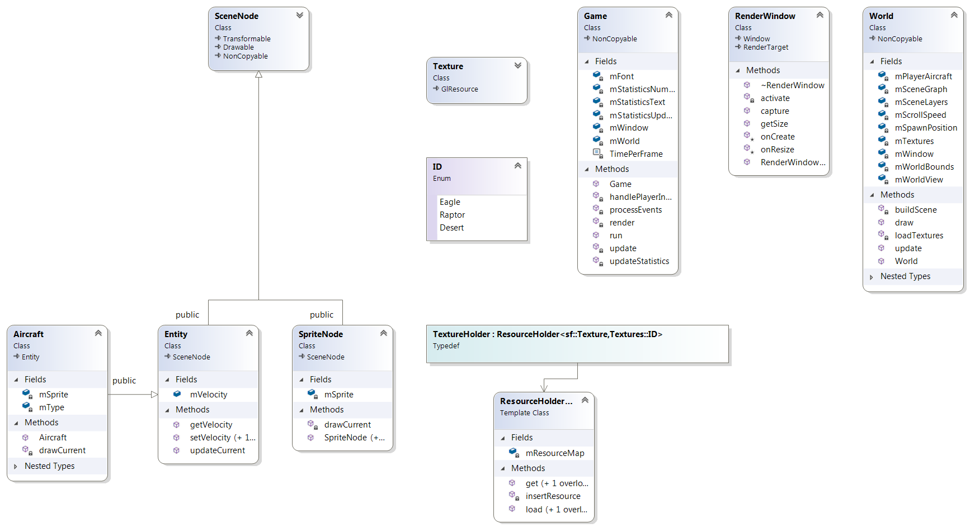
World

